Slide 1

ACADEMIC YEAR 2021-2022
A
PROJECT REPORT ON
“Online Voting System”
SUBMITTED TO SAVITRIBAI PHULE PUNE UNIVERSITY BY
Srujan Wadgaonkar(213431078)
MODERN COLLEGE OF ARTS, SCIENCE AND
COMMERCE, GANESHKHIND, PUNE-16
Submitted To – Prof. Pogul Roja Ma’am

Slide 2
INDEX
Introduction.
Requirement Specification
Input/Output Screen.
Advantages And Disadvantages.
Conclusion.
Bibliography.

Slide 3
Introduction
At the end of any political term, millions of voters are called upon to cast their votes for their next political representatives. Unfortunately, many eligible voters will not be able to reach a polling station during the election.
Some are living abroad or are deployed in the military. Some have disabilities and face inaccessible polling locations. Some simply don’t have the means to take the time to vote, whether it be due to a job, to travels, or to living far away from a voting center.

Slide 4
Requirement Specifications
Software Requirement:-
Frontend: HTML
Backend: MySQL, PHP
Database: MySQL
Operating System: Windows
Hardware Requirement:-
Ram: 2GB
Processor: Dual Core
Storage: 200MB

Slide 5
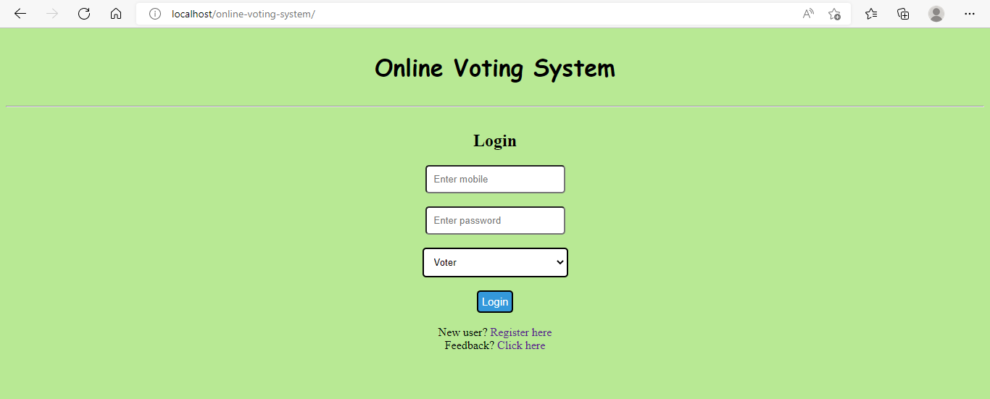
Input Screen
User Login : -
Home page :-

Slide 6
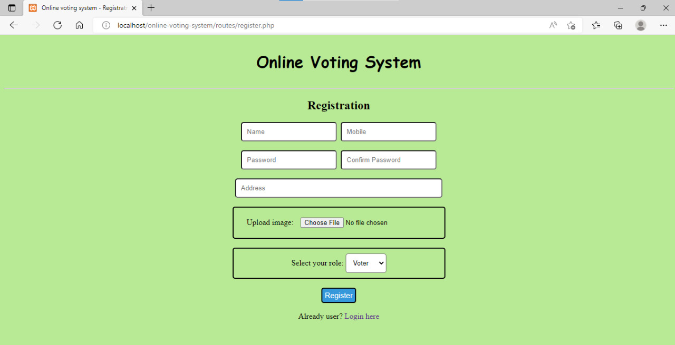
Registration Page :-

Slide 7
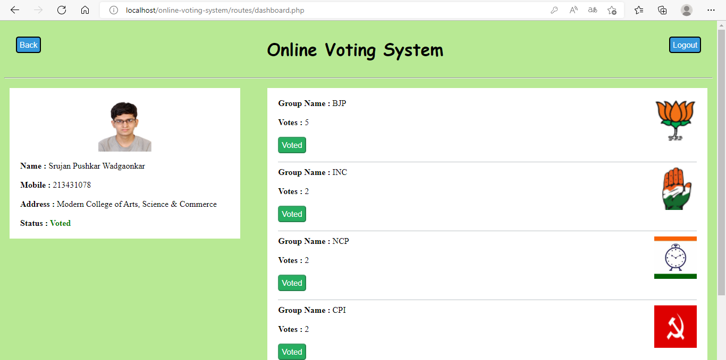
User page :-

Slide 8
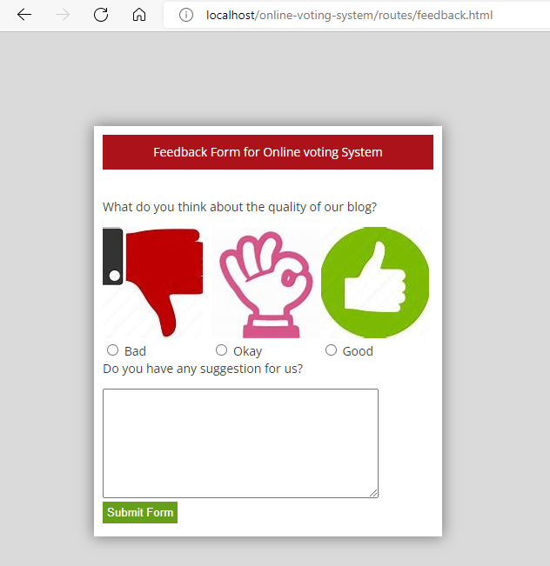
Feedback Form :-

Slide 9
Advantages :-
Efficiency
Reports
Security
Decrease in Cost

Slide 10
Disadvantages :-
The high cost of construction or installation
Regular maintenance
Operation
Breakdown

Slide 11
Conclusion :-
Online Voting Systems have many advantages over the traditional voting system. Some of these advantages are less cost, faster generation results, easy accessibility, accuracy, and low risk of human and mechanical errors. It is very difficult to develop online voting system which can allow security and privacy on the high level. Future development focused to design a system which can be easy to use and will provide security and privacy of votes on acceptable level by proper authentication and processing section.. It is easy to use and it is less time consuming. It is very easy to debug.

Slide 12
Bibliography :-
www.javatpoint.com
www.tutorialspoint.com
www.stackoverflow.com
www.github.com
www.youtube.com

Slide 13
Thank You !!!

